Slide 1

UNITE THE DATA, UNLOCK YOUR INSIGHTS
Analytics Avenue Research and Development
Transform Your Media Analytics Journey!
ajayprabakaran1202@gmail.com

Slide 2













Flow Diagram of Media Analytics
Dashboard & Reports
Real-Time Visualization
Operational Applications
ML/AI Prediction & Monitoring
Executive and custom experience
Unstructured Data
Data warehouse
Data collection
Data Analysis
Data Visualization

Slide 3




Media Analytics Mechanism Work-Flow
Collect data from social media platforms, websites, CRM systems, Marketing Automation tools, advertising platforms and surveys
Tools: APIs, web-scraping tools and survey tools
Data collection
Data Cleaning and Preprocessing
Data Integration
Data Analysis
Data Visualization
Reporting and Decision-Making

Slide 4




Media Analytics Mechanism Work-Flow
Remove duplicates, handle missing values and normalize data formats to ensure consistency
Cleaning: Handling Missing Values, Removing Duplicates and Correcting Errors.
Preprocessing: Normalization, Standardization, Encoding Categorical Data, Feature Engineering, Outlier Detection and handling, Data Integration.
Data collection
Data Cleaning and Preprocessing
Data Integration
Data Analysis
Data Visualization
Reporting and Decision-Making

Slide 5




Media Analytics Mechanism Work-Flow
Data collection
Merge data from different sources into a unified dataset or data warehouse for comprehensive analysis.
It involves combining data from different sources to provide a unified view, which helps in comprehensive analysis and Decision-making.
Data Cleaning and Preprocessing
Data Integration
Data Analysis
Data Visualization
Reporting and Decision-Making

Slide 6


Media Analytics Mechanism Work-Flow
Data collection
Data Cleaning and Preprocessing
Techniques: Apply statistical analysis, machine learning and natural language processing(NLP) to extract insights and identify patterns.
Data Integration
Data Analysis
Data Visualization
Reporting and Decision-Making

Slide 7


Data collection
Media Analytics Mechanism Work-Flow
Data Cleaning and Preprocessing
Data Integration
Data Analysis
Create visual representations of data to communicate insights effectively.
Data Visualization
Reporting and Decision-Making

Slide 8


Data collection
Data Cleaning and Preprocessing
Media Analytics Mechanism Work-Flow
Data Integration
Data Analysis
Data Visualization
Generate reports and share insights with stakeholders to inform decision making processes
Reporting and Decision-Making

Slide 9
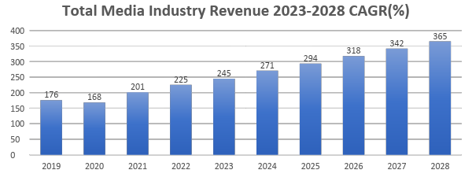
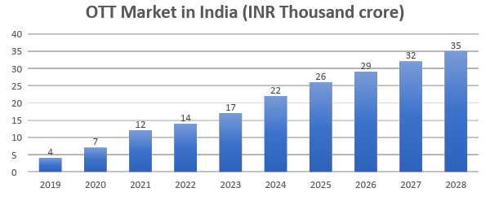
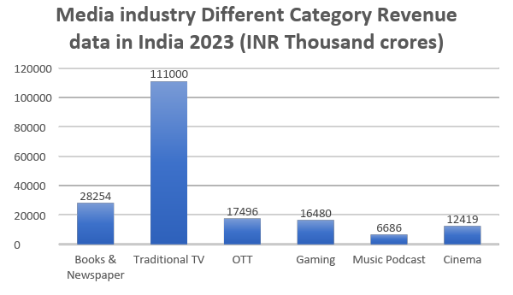
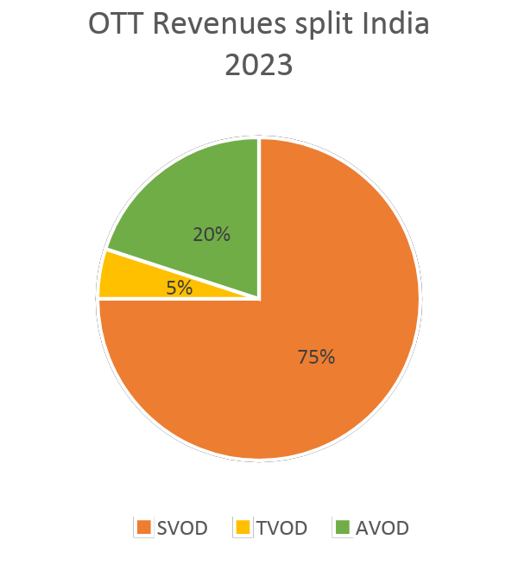
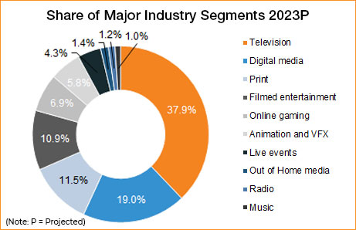
Media Industry - Market Analysis of India

Slide 10
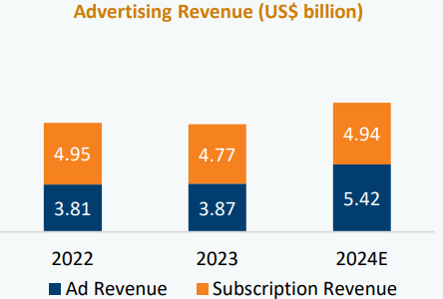
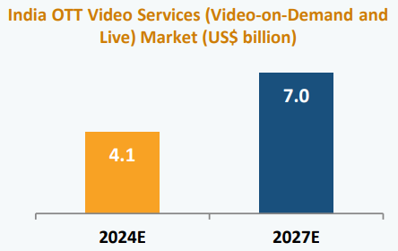
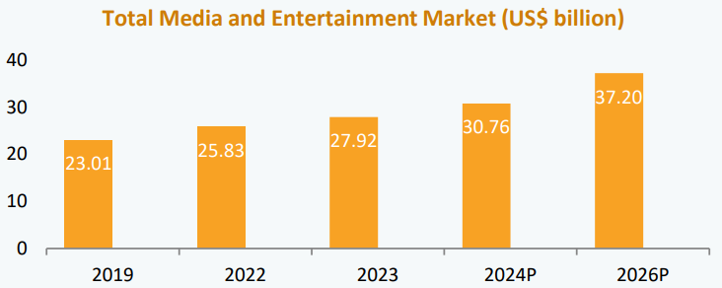
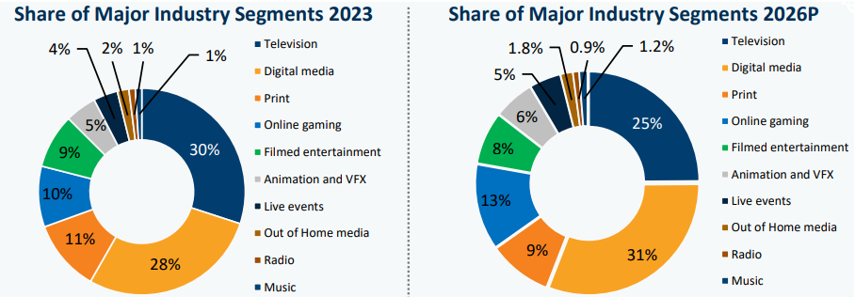
Media Industry - Market Analysis of India
Robust demand: According to a FICCI-EY report, the advertising to GDP ratio is expected to reach 0.4% by 2025 from 0.38% in 2019. The country's entertainment and media industry is expected to see a growth of 9.7% annually in revenues to reach US$ 73.6 billion by 2027.
Higher Investments: FDI inflows in the information and broadcasting sector (including print media) stood at US$ 10.99 billion between April 2000-March 2024. In the Interim budget of 2024-25 the Ministry of Information and broadcasting was allocated Rs. 4,342.55 crore (US$ 523.20 million). The Indian gaming sector has raised a total of US$ 2.8 billion from domestic and global investors, over the last five years.
Policy support: On February 25, 2021, the government outlined the Information Technology (Intermediary Guidelines and Digital Media Ethics Code) Rules 2021. In February 2024, the Union Cabinet approved the auction of 10,523.15 megahertz (MHz) of spectrum across bands at a reserve price of Rs 96,317.65 crores (US$ 11.60 billion).
Attractive opportunities: India’s Animation and VFX sector is projected to grow from US$ 1.3 billion in 2023 to US$ 2.2 billion by 2026, increasing its share of the media and entertainment (M&E) industry from 5% to 6%, according to a CII GT report

Slide 11


Media Industry Market Analysis
“You can have data without information, but you cannot have information without data.”
Capabilities | Business Impact
Optimizing Content Performance: Analytics tools help identify which content performs best, allowing companies to focus on high-performing content. By analyzing trends, companies can predict popular content and plan accordingly. Understanding Audience Behavior: Understanding audience preferences, behaviors, and engagement patterns allows for personalized content recommendations, improving user experience and satisfaction. Enhancing Advertising Strategies: Analytics enables precise targeting of ads to specific audience segments, increasing ad effectiveness and ROI. Real-time tracking and adjustments optimize ad performance. Predictive Analytics: Predicting future trends based on historical data helps companies stay ahead of the curve. Predictive models assist in planning and creating content that aligns with upcoming trends. Revenue Growth: Identifying new revenue streams and optimizing existing ones. Data-driven insights support strategic decisions that drive revenue growth. | Enhanced Content Development: Creates engaging content, increasing user engagement and monetization by up to 30% Improved Personalization: Optimizes recommendations, boosting user retention and monetization by 20% Optimized Scheduling: Identifies peak times and preferred content, enhancing viewer engagement by 15% Advertising Effectiveness: Accurately measures ad campaign impact, increasing ad revenue by 25% Real-Time Monitoring: Quickly responds to customer queries, boosting customer lifetime value by 10% Market Research: Provides insights into trends and preferences, increasing market share by 20%.market share by 20%. Content Monetization: Real-time insights help identify high-performing content, leading to better monetization strategies and a potential increase in revenue by 15% User Engagement: Real-time data allows for dynamic content adjustments, improving user engagement rates by up to 25%.

Slide 12

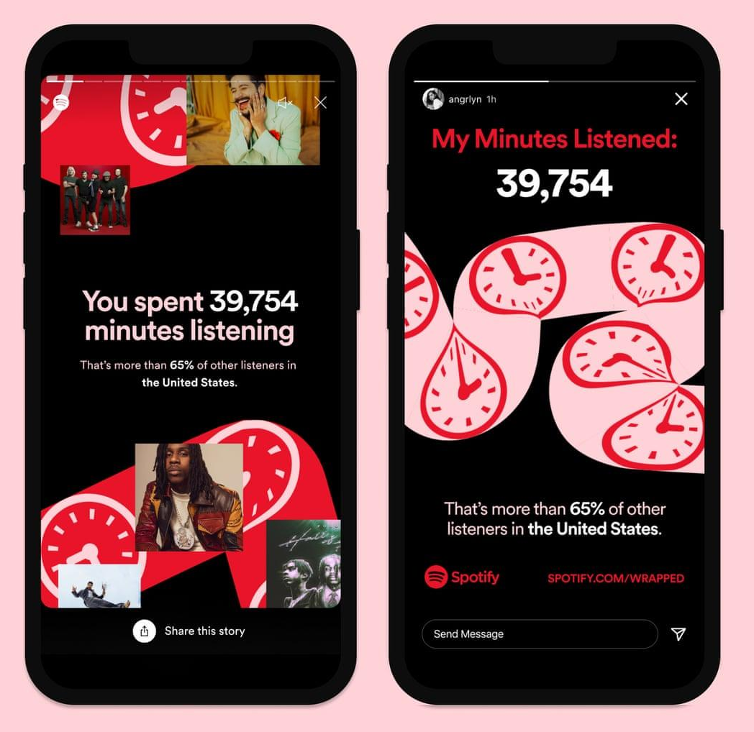
Media Industry – Spotify “Wrapped” Case Study
In 2013, Spotify launched "Year in Review," showcasing streaming data with on-brand graphics that captivated audiences.
By 2016, it evolved into "Wrapped," adding features like "audio aura" and "listening personality types" based on users' habits.
Why this campaign?
The campaign leverages users' love for personalization and nostalgia, allowing them to reflect on their past year's music and share their habits. This annual event generates buzz, retaining customers and attracting new sign-ups.
What did they do?
Spotify uses vast listening data to create eye-catching, shareable graphics on Facebook, Instagram, and X, enhancing shareability and personalization, driving the viral success of Spotify Wrapped.
How did it help?
In 2022, over 156 million users interacted with their Wrapped summaries. Within the first three days, the campaign generated over 400 million tweets/X posts, demonstrating strong shareability and user engagement.

Slide 13

Artificial Intelligence in Media Industry
Effects of AI in Media Industry:
Content Development: AI algorithms analyze data to create content for specific audiences. Examples include Netflix recommending shows and Storyful finding viral content.
New Types of Content: AI produces virtual influencers and enhances user experiences with AI-powered chatbots like Alexa.
Personalization: AI provides tailored recommendations for music, content, and games, increasing user satisfaction.
Character Modeling and Animation: AI improves 3D models in movies and games, and aids in creating custom soundtracks.
Content Development Efficiency: AI automates video editing, proofreading, and ad writing, reducing costs and boosting productivity.
Audience Engagement and Marketing: AI enables precise ad targeting and enhances marketing campaigns by analyzing consumer behavior.
Advantages of AI in Media Industry:
Personalization: AI provides personalized suggestions for films, TV series, and music, increasing content engagement and user retention.
Production Efficiency: AI automates processes like narration, post-production, and video editing, saving time and money.
Audience Reaction: AI analyzes audience behavior to improve content and boost engagement, enhancing the user experience.
Marketing and Promotion: AI creates targeted marketing plans based on user data and trends, improving marketing ROI.
Improved Decision-Making: AI helps businesses make better decisions by analyzing data, supporting marketing and product development.
Lower Costs: AI automation reduces labor and utility costs by minimizing the need for human labor and optimizing energy use.

Slide 14


AI’s effect in Media Industry
Netflix, available in 190 countries, has revamped its tech stack using ML and AI to analyze watch history and determine bandwidth. Metadata helps Netflix understand viewers' preferences and emotions, enabling tailored content highlights. To prevent buffering, Netflix uses AI in adaptive bitrate streaming, adjusting video quality based on device capabilities and internet speed.
Amazon Prime, With the use of AI and machine learning, Amazon has improved its operations and increased operational efficiency. Alexa is a well-liked product from Amazon. This intelligent speaker, accessible in 80 countries and 15 languages, continuously improves business by creating customized content.

Slide 15
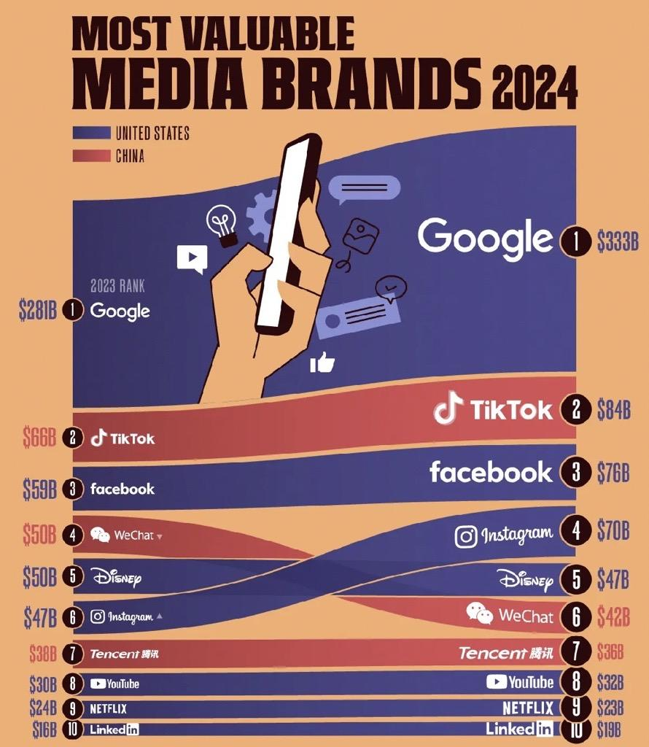
Media Industry
Market Analysis

Slide 16
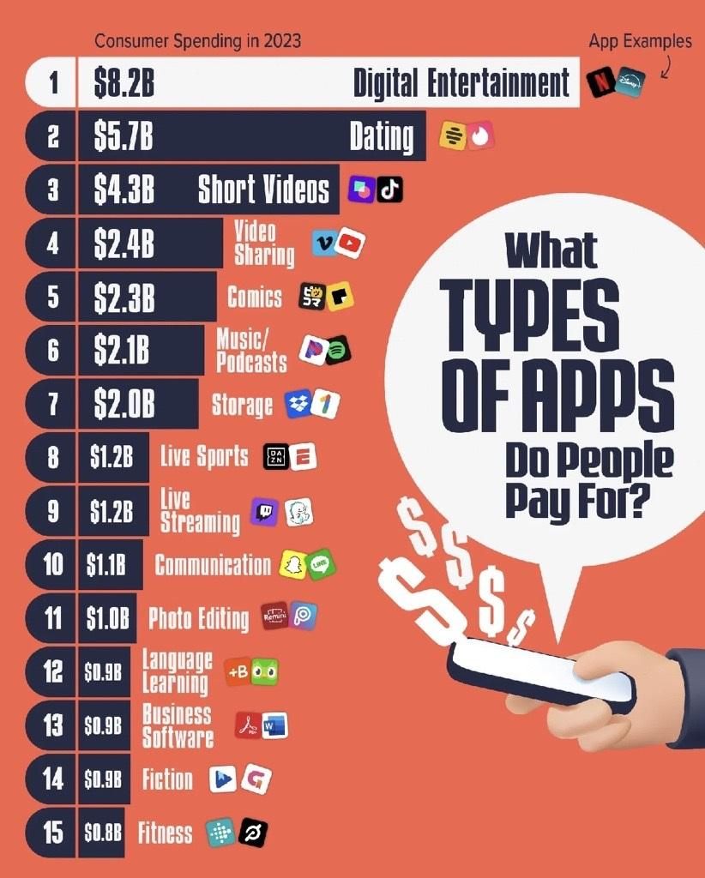
Media Industry
Market Analysis

Slide 17
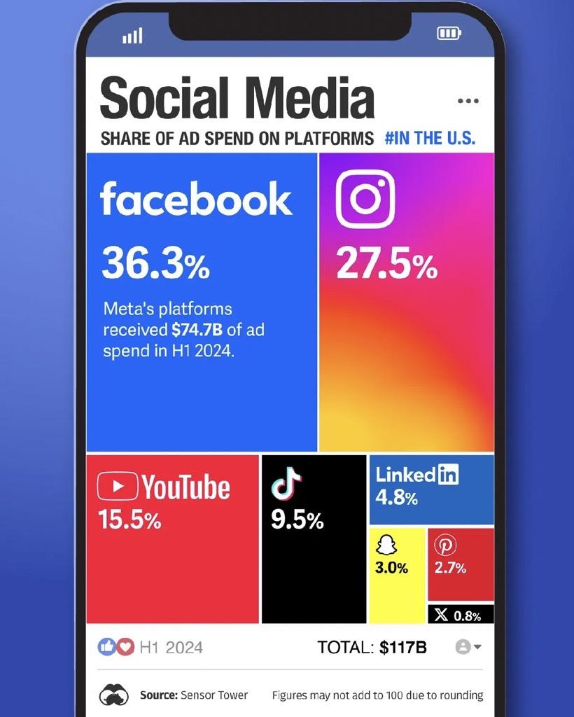
Media Industry
Market Analysis

Slide 18
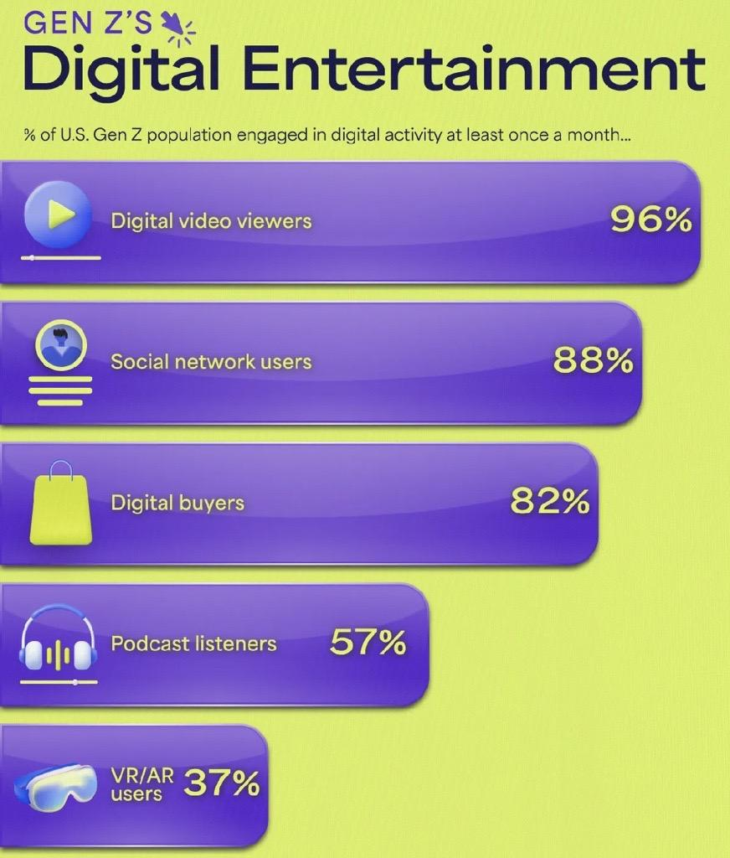
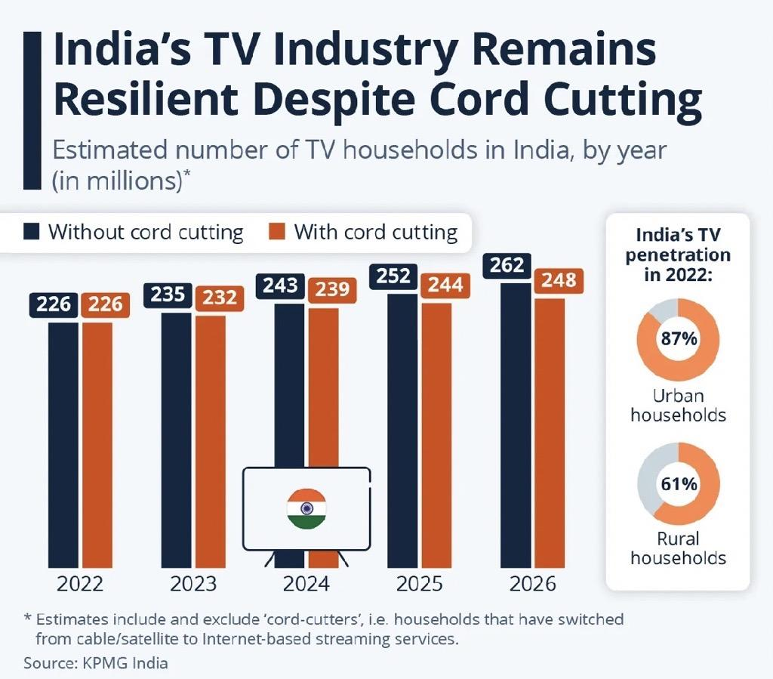
Media Industry Market Analysis

Slide 19
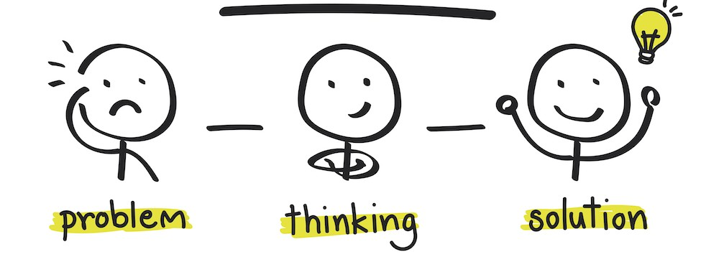
“A Problem is a chance for you to do your best”
Thank You!

